Slide 1
UNIT-III: Energy Resources, Electricity Bill & Safety Measures
Energy Resources: Conventional and non-conventional energy resources; Layout and operation of various Power Generation systems: Hydel, Nuclear, Solar & Wind power generation.
Electricity bill: Power rating of household appliances including air conditioners, PCs, Laptops,Printers, etc. Definition of used for consumption of electrical energy, two-part electricity tariff, calculation of electricity bill for domestic consumers.
Equipment Safety Measures: Working principle of Fuse and Miniature circuit breaker (MCB), merits and demerits.
Personal safety measures: Electric Shock, Earthing and its types,Safety Precautions to avoid shock.

Slide 2
SOURCES OF ENERGY:
The two major sources of energy is classified as:
Conventional Sources
Non-Conventional Sources

Slide 3
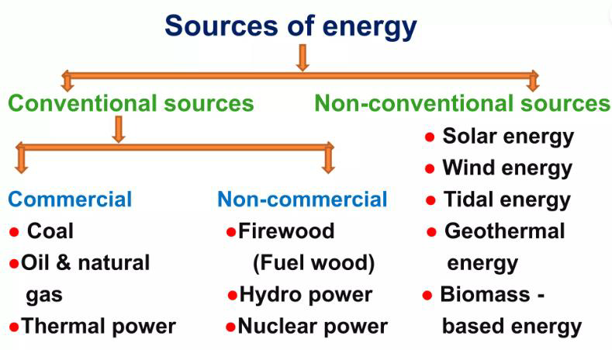

Slide 4
Conventional Sources of energy
The conventional sources of energy are generally non-renewable sources of energy, which are being used since a long time.
Conventional Sources of Energy Types:-
    Coal
    Oil and Natural Gas
    Thermal Power
    Firewood (Fuelwood)
    Hydro power
    Nuclear energy

Slide 5
Coal:
Coal is the most important source of energy.
There are more than 148790 coal deposits in India, and between 2005-2006, the annual production went up to 343 million tons.
India is the fourth-largest coal-producing country, and the deposits are primarily found in Bihar, Orissa, Madhya Pradesh, Jharkhand and Bengal.
Oil and Natural Gas:
Oil is considered liquid gold and one of the crucial energy sources in India and the world.
Oil is primarily used in planes, automobiles, trains and ships.
The total oil production in India was 0.3 million tons in 1950-51, which increased up to 32.4 million tons in 2000-01.
It is mainly found in Assam, Gujarat and Mumbai.

Slide 6
Thermal Power:
Thermal power is generated at various power stations utilizing oil and coal.
It is a vital source of electric current
Hydroelectric Power:
Hydroelectric power is produced by constructing dams above flowing rivers.
Nuclear Power:
The fuel used in nuclear power plants is Uranium, which costs less than coal.
Nuclear power plants can be found in Kaiga (Karnataka), Kota (Rajasthan), Naroura (UP) and Kalapakam(Chennai).

Slide 7
Non-Conventional Sources of Energy
Non-conventional sources are also known as renewable sources of energy.
Examples of non-conventional sources of energy include solar energy, bioenergy, tidal energy and wind energy.
Solar Energy:
Solar Energy is produced by sunlight.
The photovoltaic cells are exposed to sunlight based on the form of electricity that needs to be produced.
The energy is utilized for cooking and distillation of water.
Wind Energy:
Wind energy is generated by harnessing the power of wind and mostly used in operating water pumps for irrigation purposes.
India stands as the second-largest country in the generation of wind power.
Tidal Energy:
Tidal energy is generated by exploiting the tidal waves of the sea.
This source is yet to be tapped due to the lack of cost-effective technology.

Slide 8
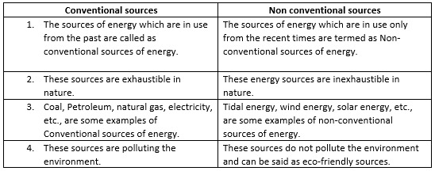

Slide 9
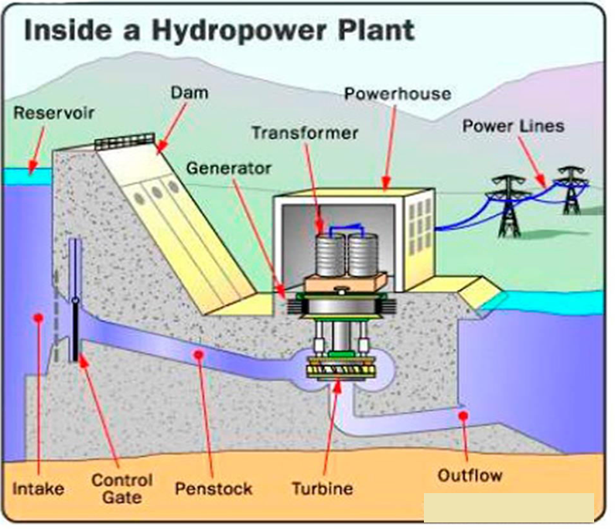

Slide 10
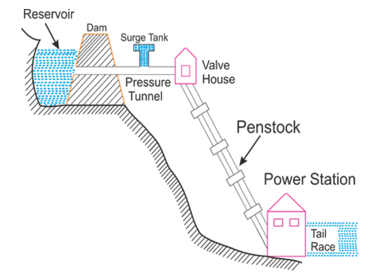

Slide 11
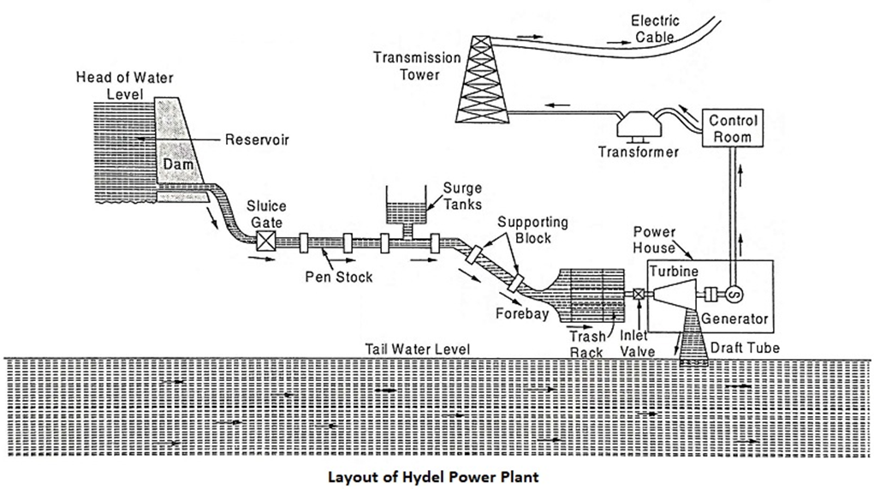

Slide 12
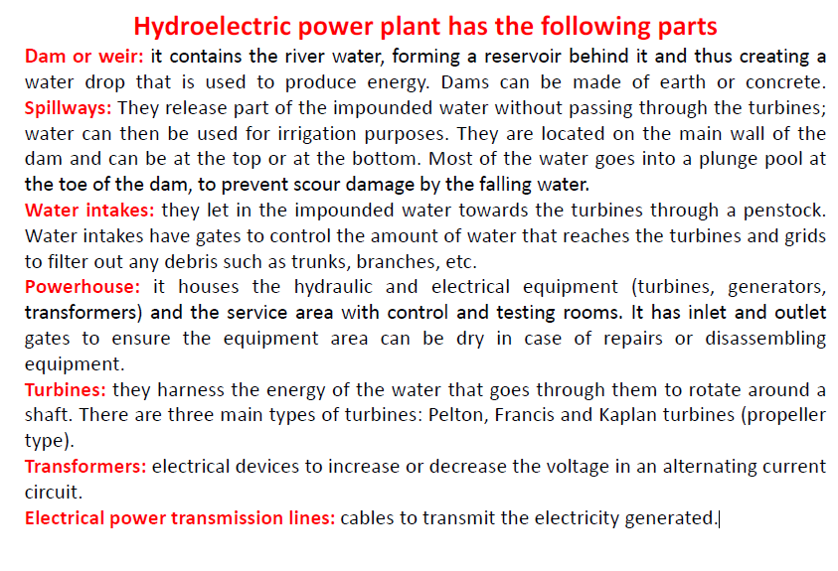

Slide 13
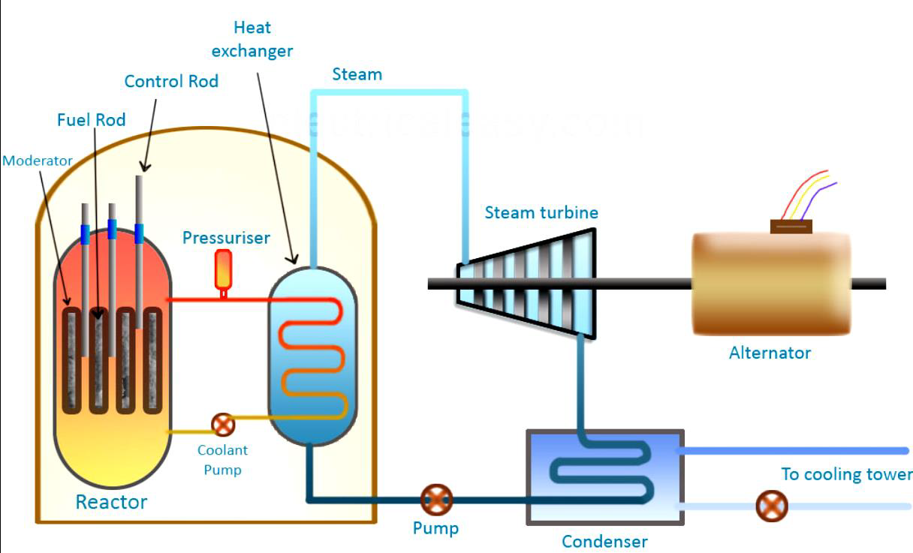
LAYOUT AND OPERATION OF NUCLEAR POWER GENERATION SYSTEM

Slide 14
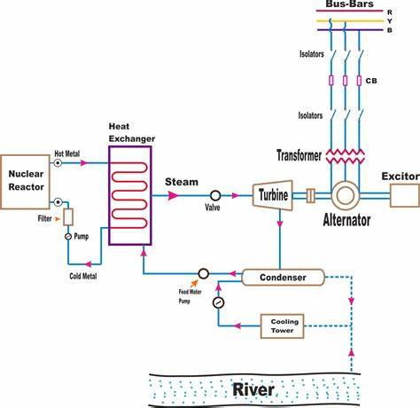

Slide 15
In a nuclear power plant, heat energy is generated by a nuclear reaction called as nuclear fission.
Nuclear fission of heavy elements such as Uranium or Thorium is carried out in a special apparatus called as a nuclear reactor.
A large amount of heat energy is generated due to nuclear fission.
Heavy elements such as Uranium (U235) or Thorium (Th232) are subjected to nuclear fission reaction in a nuclear reactor.
Due to fission, a large amount of heat energy is produced which is transferred to the reactor coolant.
The coolant may be water, gas or a liquid metal.
The heated coolant is made to flow through a heat exchanger where water is converted into high-temperature steam.
The generated steam is then allowed to drive a steam turbine.
The steam after doing its work, is converted back into the water and recycled to the heat exchanger.
The steam turbine is coupled to an alternator which generates electricity.
The generated electrical voltage is then stepped up using a transformer for the purpose of long-distance transmission.

Slide 16
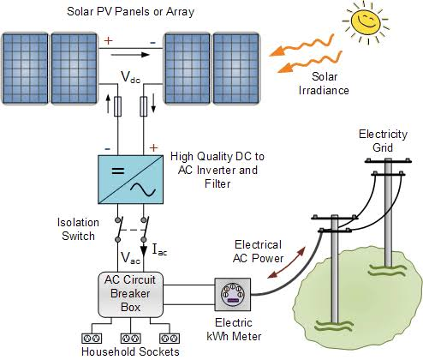
LAYOUT AND OPERATION OF SOLAR POWER GENERATION SYSTEM

Slide 17
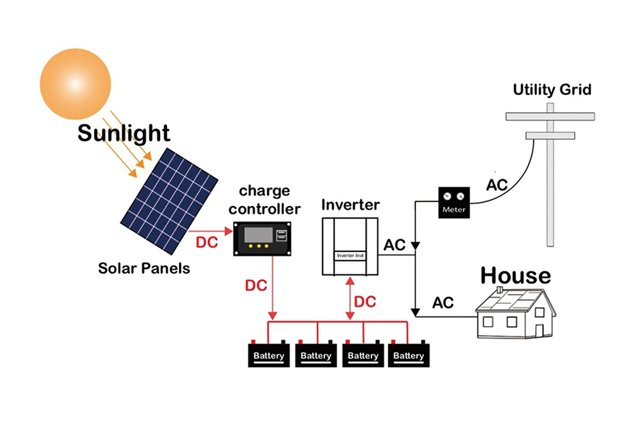

Slide 18
Solar photovoltaic (PV) panels use cells containing a semi-conductor material to capture the sun’s energy and convert solar radiation into electricity.
The most commonly used semi-conductor material is silicon.
When light strikes the cell a certain amount of energy is absorbed within the semiconductor material, knocking electrons, the negatively charged particles that form the basis of electricity.
Most PV cells have two layers of semi-conductor material, one positively charged and one negatively charged.
When light shines on the semi-conductor the electric field across the junction between these two layers causes electricity to flow, generating direct current (DC).

Slide 19
Direct Current (DC) needs to be converted into alternating current (AC) so it can be used in a domestic building; this is performed by an inverter.
The AC electricity then passes via the generation meter, which measures how much electricity has been created, and on to the consumer unit where it can be fed into the property for use or exported back to the national grid via the electricity meter.

Slide 20
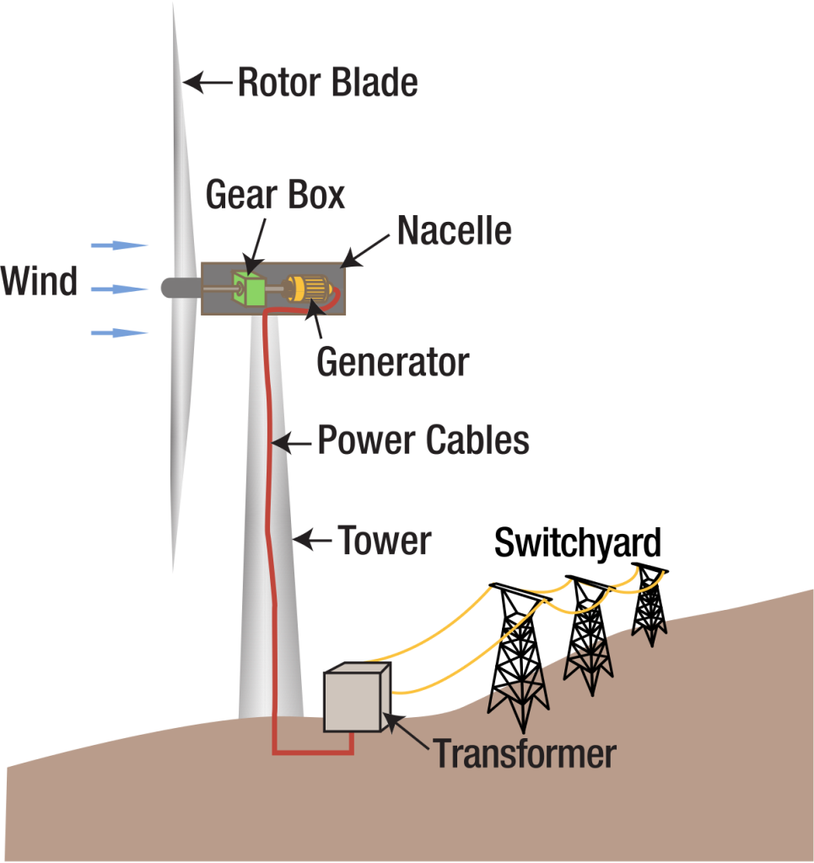
LAYOUT AND OPERATION OF WIND POWER GENERATION SYSTEM

Slide 21
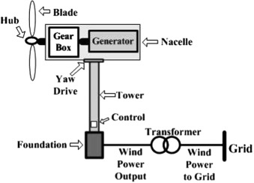

Slide 22
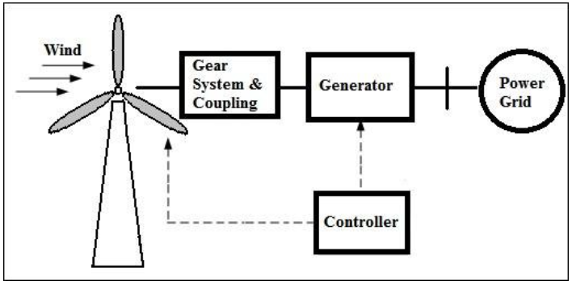

Slide 23
Wind Turbine: Converts wind energy into rotational (mechanical) energy
Gear system and coupling: It steps up the speed and transmits it to the generator rotor
Generator: Converts rotational energy into electrical energy.
Controller: Senses wind direction, wind speed, generator output and temperature and initiates appropriate control signals to take control action.
There are two basic types of wind turbines (WT): horizontal axis wind turbines (HAWT) and vertical axis wind turbines (VAWT).

Slide 24
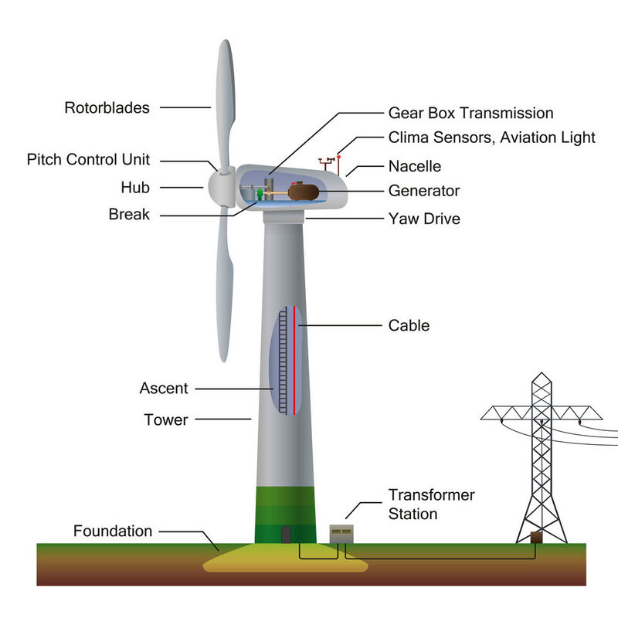

Slide 25
Wind Power plants are a collection of wind turbines either horizontal or vertical type.
These turbines collect the energy individually and are connected to a common plant.
The wind turbine is also similar to the normal turbine, as it converts kinetic energy into mechanical energy.
The wind turbine works on the principle of conversion of kinetic energy of wind to mechanical energy used to rotate the blades of a fan connected to an electric generator.
When the wind or air touches the blades (or) vanes of the windmill it the air pressure can be uneven, higher on one side of the blade and lower on the other.
Hence, uneven pressure causes the blades to spin around the center of the turbine.
The turbine does not operate at wind speeds above 55 mph with the use of the controller.

Slide 26
The rotor shaft of the turbine (i.e., low speed and high speed) is interlinked with the gearbox which converts the speed from 30 to 60 rpm into 1000 to 1800 rpm.
As the gearbox consists of gears, to transmit mechanical energy.
These speeds are most suitable to the generator for the generation of electricity.
When the rotor of the turbine rotates it drives a generator through a setup gearbox causing the generator to produce electrical energy.

Slide 27
ESTIMATION OF ELECRICIT`Y BILL
POWER RATING OF HOUSEHOLD APPLIANCES:
The rating of electrical appliance indicates the voltage at which the appliance is designed to work and the current consumption at that voltage.
The Energy consumption of a device is calculated by multiplying the wattage of a device and operational hours.

Slide 28
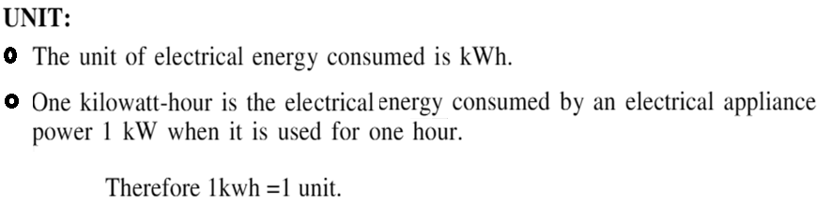
UNIT

Slide 29
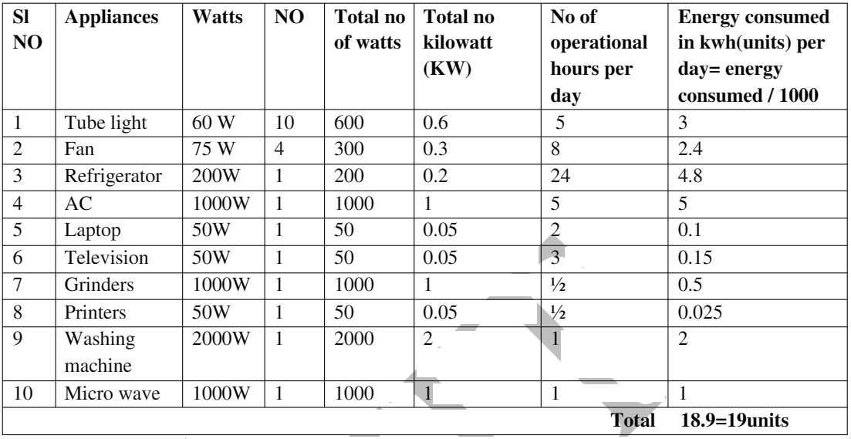

Calculation Of Power Consumtion Of Electrical Home Appliances

Slide 30
TARIFF:
The rate at which electrical energy is supplied to a consumer is known as tariff.
Objectives of tariff:
Recovery of cost of producing electrical energy at the power station.
Recovery of cost on the capital investment in transmission and distribution systems.
Recovery of cost of operation and maintenance of supply of electrical energy e.g., metering equipment, billing etc.
A suitable profit on the capital investment

Slide 31
Two-part tariff:
When the rate of electrical energy is charged on the basis of maximum demand of the consumer and the units consumed, it is called a two-part tariff.
In two-part tariff, the total charge to be made from the consumer is split into two components
fixed charges and running charges
The fixed charges depend upon the maximum demand of the consumer.
The running charges depend upon the number of units consumed by the consumer.

Slide 32
Total charges = Rs (b ⨯ kW + c ⨯ kWh)
where, b = charge per kW of maximum demand
c = charge per kWh of energy consumed
This type of tariff is mostly applicable to industrial consumers who have appreciable maximum demand.
Advantages:
It is easily understood by the consumers.
It recovers the fixed charges which depend upon the maximum demand of the consumer but are independent of the units consumed.
Disadvantages:
The consumer has to pay the fixed charges irrespective of the fact whether he has consumed or not consumed the electrical energy.
There is always error in assessing the maximum demand of the consumer.

Slide 33
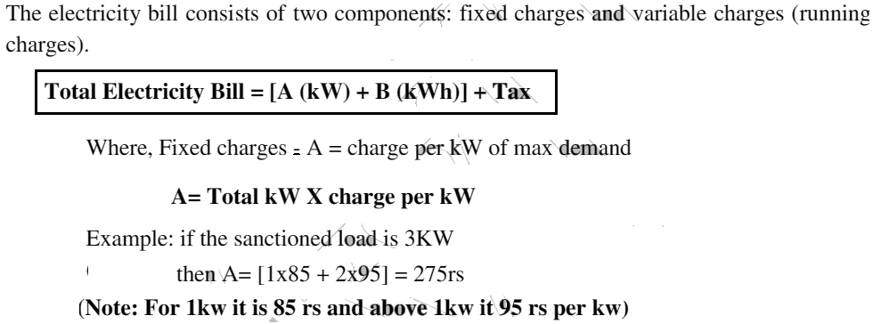
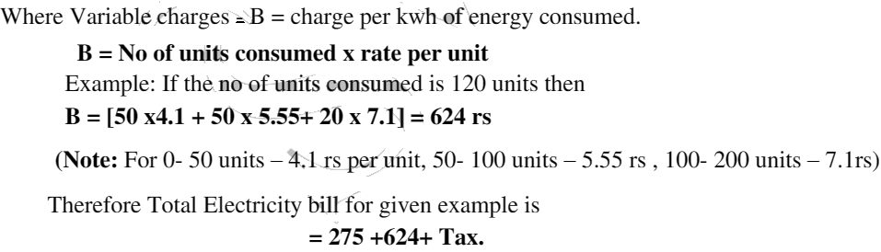
Calculation Of Electricity Bill For Domestic Consumers

Slide 34
EQUIPMENT SAFETY MEASURES
WORKING PRINCIPLE OF A ELECTRICAL FUSE:
An Electrical Fuse is a safety device to limit the current in an electric circuit.
The Electrical Fuse protects the circuit from damage while exceeding current or voltage fluctuations.
Fuses are the protectors, these are the safety devices which are used to protect the home appliances like televisions, refrigerators, computers with damage by high voltage.
A fuse consists of a piece of wire made of a metal or an alloy of an appropriate melting point, for example, aluminium, copper, iron, lead etc.
If a current larger than the specified value flows through the circuit, the temperature of the fuse wire increases. This melts the fuse wire and breaks the circuit.
Electric fuse works on the principle of the heating effect of electric current (Joule’s law of heating). It is placed in series with the device.

Slide 35
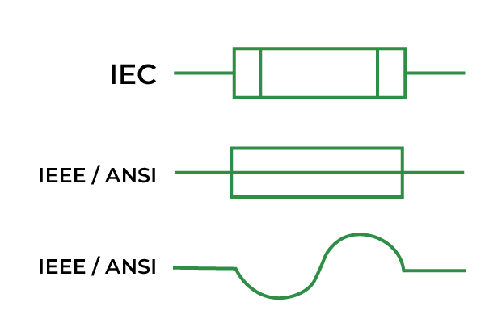
Definition: A fuse is a piece of metal which is inserted in the circuit & melts when current passes through it exceeds its rated limit.
The following diagram shows the symbols of an electrical fuse used:
Symbols of a Fuse

Slide 36
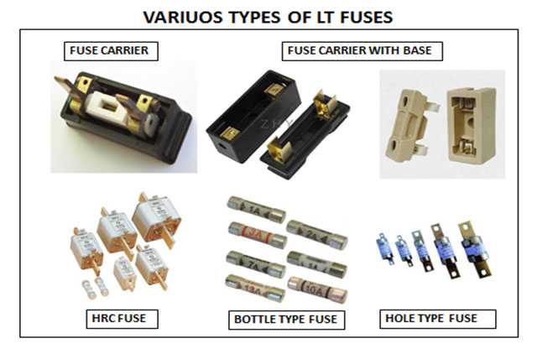

Slide 37
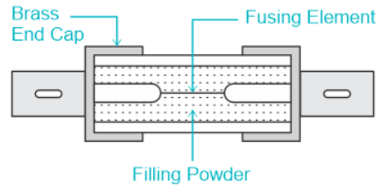
Filling powder fills the internal space of the fuse body. The filling powder materials used in fuse are quartz, Plaster of Paris, dust, marble, and chalk.

Slide 38
Fuse Working Principle
An electric fuse operates on the heating effect of current theory and follows that current flows in a loop and if there is a break in a loop ,electric charges cannot flow through it .
Electric Fuse is made up of thin metallic wire which is non-flammable and has low melting point.
When excessive amount of heat is passed through the fuse, it melts down which leads to opening of circuits and the blockage of current .
The melted fuse then can be replaced with new one.
Basically , if large amount of electricity flows through a fuse (larger amount of electricity than the capacity of the fuse to bear), it heats up so much that it starts to melt.
Fuse is normally made up of zinc, Aluminium, copper and silver.

Slide 39
Functions of Electric Fuse
The function of an electric fuse is to protect electrical circuits and devices from excessive current or short circuits.
It is a safety device that acts as a sacrificial element in the circuit.
Some of its main functions are as follows.
    The electric fuse acts as a protective barrier between the electrical circuit and the human body.
    It safeguards against device failure resulting from faulty circuit operation.
    The fuse prevents short circuits from occurring.
    It helps prevent overloads and blackouts.
    The fuse safeguards against damage caused by mismatched loads.

Slide 40
Advantages of Electrical Fuse
    Protect circuits and wiring
    Simple and reliable
    Low cost
    Easy to replace
    Fuses come in a wide range of current and time ratings to match the requirements of different circuits
Disadvantages of Electrical Fuse
    Manual intervention is required as there is no automatic reset.
    Components can still be damaged in the short time before the fuse interrupts excessive current
    Fuses completely interrupt power to the circuit when they blow, disrupting the operation of connected devices.
    A single fuse protects an entire circuit. If it fails for any reason, the whole circuit loses power

Slide 41
Working Principle Of Miniature Circuit Breaker
What Is A Miniature Circuit Breaker?
Miniature Circuit Breaker is a safety accessory with an electro-mechanical mechanism of action.
MCB is an automatic switch that opens when excessive current flows through the circuit. It can be reclosed without any manual replacement.
Whenever there is a fault in the circuit, the switches in the MCB automatically shut down and the fault of the device can be easily detected.
Handling MCB is relatively safe, and it quickly restores the supply.
MCB – Miniature Circuit Breaker can be reset quickly and does not demand more maintenance costs.
MCB works on a bi-metal respective principle that protects against overload current and solenoid short circuit current.
In recent days the fuse has been replaced by a much more efficient and small electronic device known as MCB – Miniature Circuit Breaker.

Slide 42
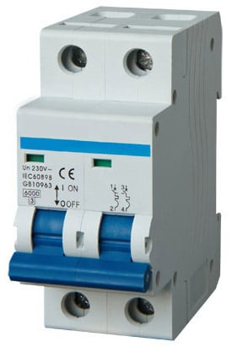
Miniature Circuit Breaker

Slide 43
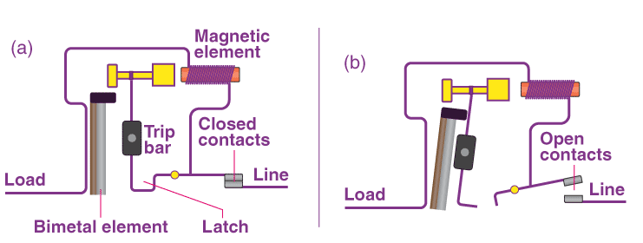
Working Principle of MCB

Slide 44
When the current overflow occurs through MCB,the bimetallic strip gets heated and deflects by bending.
The deflection of the bi-metallic strip releases a latch.
The latch causes the MCB to turn off by stopping the current flow in the circuit.
This process helps safeguard the appliances or devices from the hazards of overload or overcurrent.
To restart the current flow, MCB must be turned ON manually.
In the case of short circuit conditions, the current rises suddenly in an unpredictable way, leading to the electromechanical displacement of the plunger associated with a solenoid.
The plunger hits the trip lever, which causes the automatic release of the latch mechanism by opening the circuit breaker contacts.

Slide 45
ADVANTAGES:
    • MCBs have more sensitive to current then fuse.
    • It has quick work against short circuits.
    • It works quickly on overloading and under voltage.
    • It is reusable hence less maintenance cost and less replacement cost.
    • It is very simple to resume the supply.
    • It can be easily used circuit control switch when needed.
    • Handling MCB is electricity safer than handling fuse, in case of MCB.
    • It has reliable.
    • MCB provides a better interface.
    • MCB performance immediate indication of faculty circuit.
    • The performance of MCB is good in case of earth leakage.
    • In the case of surge current, The MCB has time delay characteristics, therefore, it works properly.
    • Shorter tripping time under moderate over current than with fuses.
    • When the use of MCB, the faulty zone of the electrical circuit can be easily identified.
DISADVANTAGES:
    • The cost of the MCB is greater than the fuse.
    • The cost of the MCB distribution board is greater than the rewireable fuse board.
    • The risk of overloading of the circuit due to unqualified of the person operating than completing removed.

Slide 46
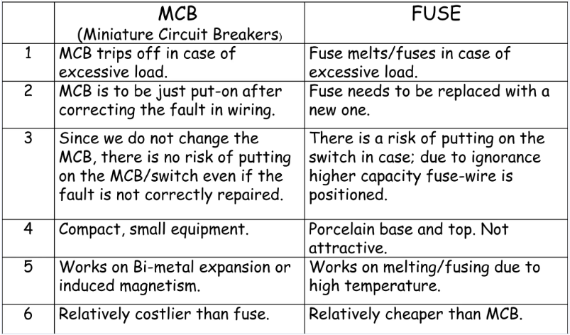

Slide 47
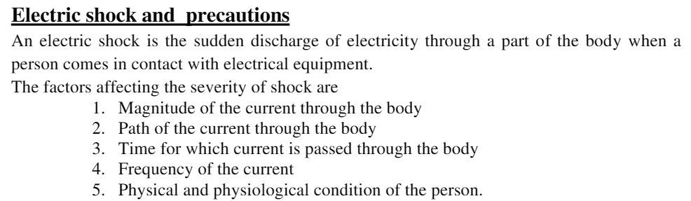
PERSONAL SAFETY MEASURES

Slide 48
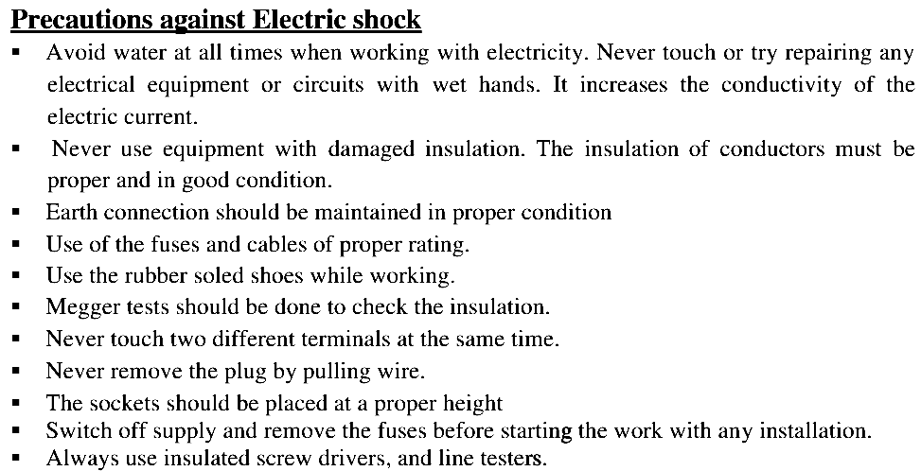

Slide 49
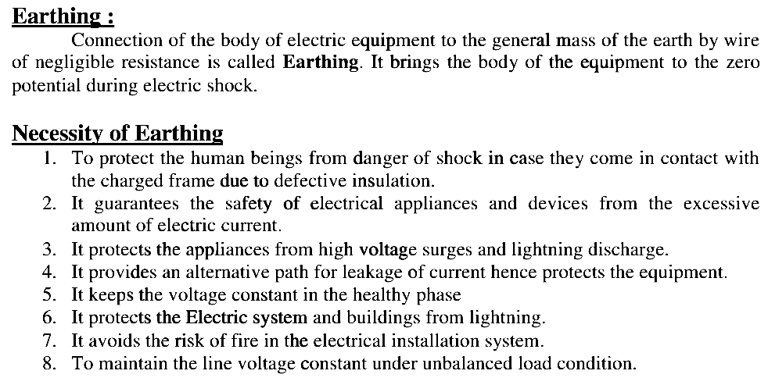

Slide 50
Earthing:
Earthing is defined as
“The process in which the instantaneous discharge of the electrical energy takes place by transferring charges directly to the earth through low resistance wire.”

Slide 51
Why Is Earthing Necessary?
Earthing serves several important purposes in electrical systems:
    Safety: Earthing minimizes the risk of electric shocks by diverting fault currents away from people and objects.
    Equipment Protection: It helps prevent damage to electrical equipment and appliances by providing a low-resistance path for fault currents.
    Lightning Protection: Proper earthing reduces the risk of lightning strikes by providing a path for lightning currents to safely dissipate into the ground.
    Electromagnetic Interference (EMI) Reduction: Earthing helps mitigate electromagnetic interference, ensuring the proper functioning of sensitive electronic devices.

Slide 52
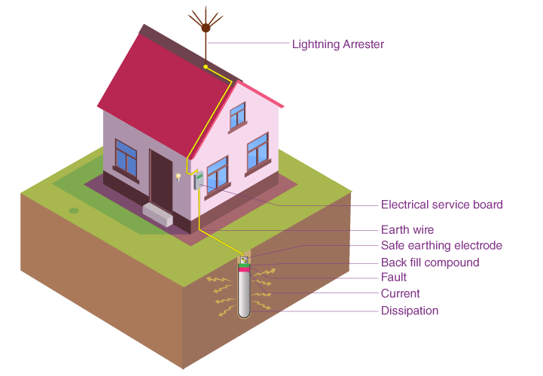
How is Earthing Done?

Slide 53
Types of Earthing:
There are three types of earthing, they are:
    Pipe earthing
    Plate earthing
    Strip or rod earthing

Slide 54
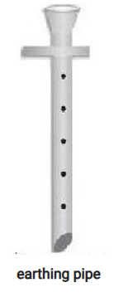
Pipe earthing:
Pipe earthing is the best and most efficient way of earthing and is also easily affordable.
Pipe earthing uses 38mm diameter and 2 metres length pipe vertically embedded in the ground to work as earth electrodes.

Slide 55
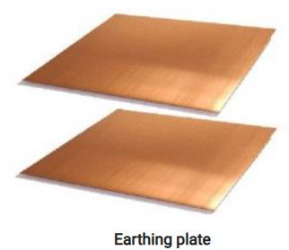
Plate earthing:
In plate earthing, an earthing plate made of copper or G.I. is buried into the ground at a depth more than 3 metres from the ground level.
This earthing plate is embedded in an alternative layer of coke and salts.

Slide 56
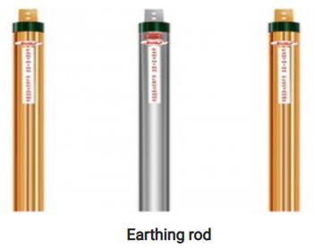
Rod Earthing:
This type of earthing is similar to pipe earthing, but a rod made of galvanized steel is used in this case.
The rod used for this purpose is buried inside the earth at a certain depth.
As it is of low resistive material, the short circuit current will be diverted to the ground safely.

Slide 57
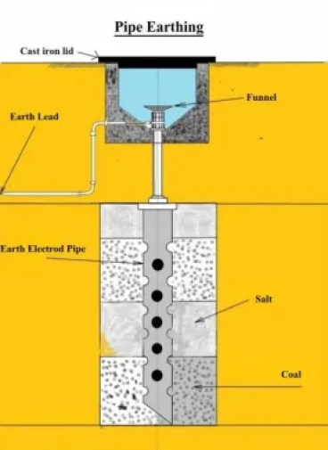

Slide 58
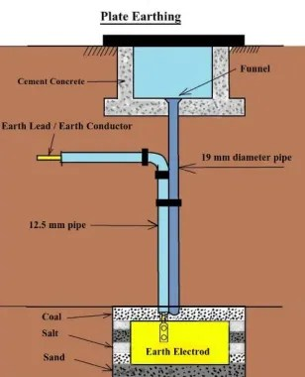

Slide 59
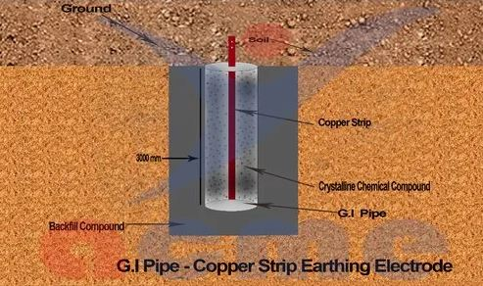

Slide 60
Thank You

